Slide 1
Linear relationships
EQ – How does the gradient differ between parallel and perpendicular lines?
Mrs James
Year 10

Slide 2
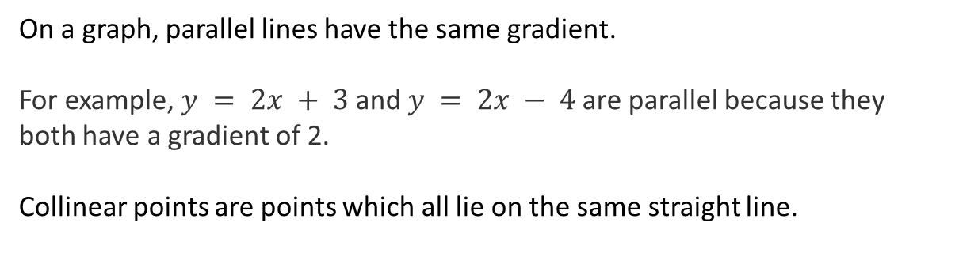
24
7
30
Date
Linear relationships
EQ – How does the gradient differ between parallel and perpendicular lines?
On a graph, parallel lines have the same gradient.
For example, $y = 2x + 3$and $y = 2x − 4$are parallel because they both have a gradient of 2.
Collinear points are points which all lie on the same straight line.
Notes:
Input

Slide 3
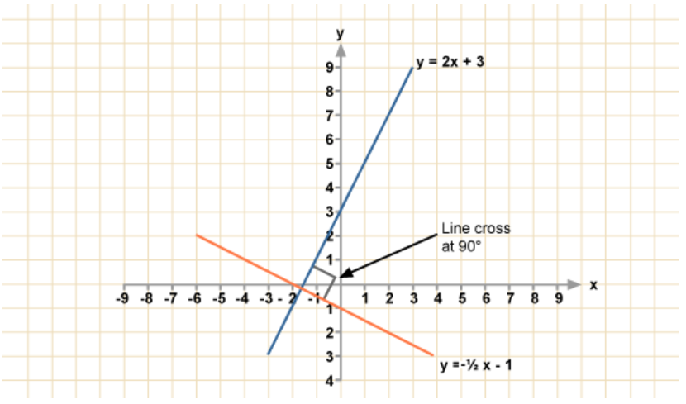
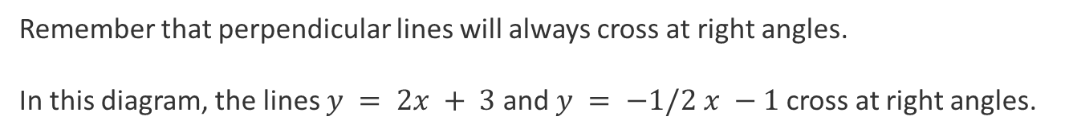
24
7
30
Date
Linear relationships
EQ – How does the gradient differ between parallel and perpendicular lines?
Remember that perpendicular lines will always cross at right angles.
In this diagram, the lines $y = 2x + 3$and $y = −1/2 x −1$cross at right angles.
Notes:
Input

Slide 4
24
7
30
Date
Linear relationships
EQ – How does the gradient differ between parallel and perpendicular lines?
The gradients of these lines are 2 and -¹/₂.
The product of the gradients is 2 x -¹/₂= -1.
You can work out whether 2 lines are perpendicular by multiplying their gradients.
The product of the gradient of perpendicular lines will always be -1.
If lines are perpendicular, M₁× M₂ = − 1
Notes:
Input

Slide 5
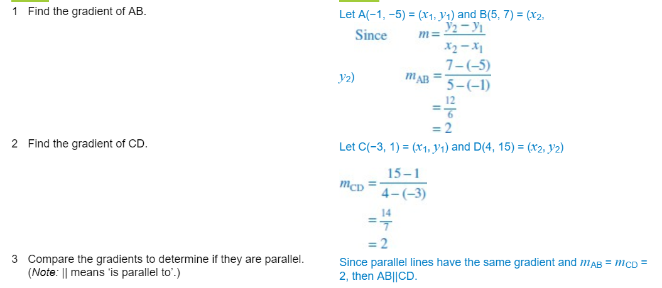
Example 1: We will do this together. Complete this in your Interactive notebook
Show that AB is parallel to CD given that A has coordinates (−1, −5), B has coordinates (5, 7), C has coordinates (−3, 1) and D has coordinates (4, 15).

Slide 6
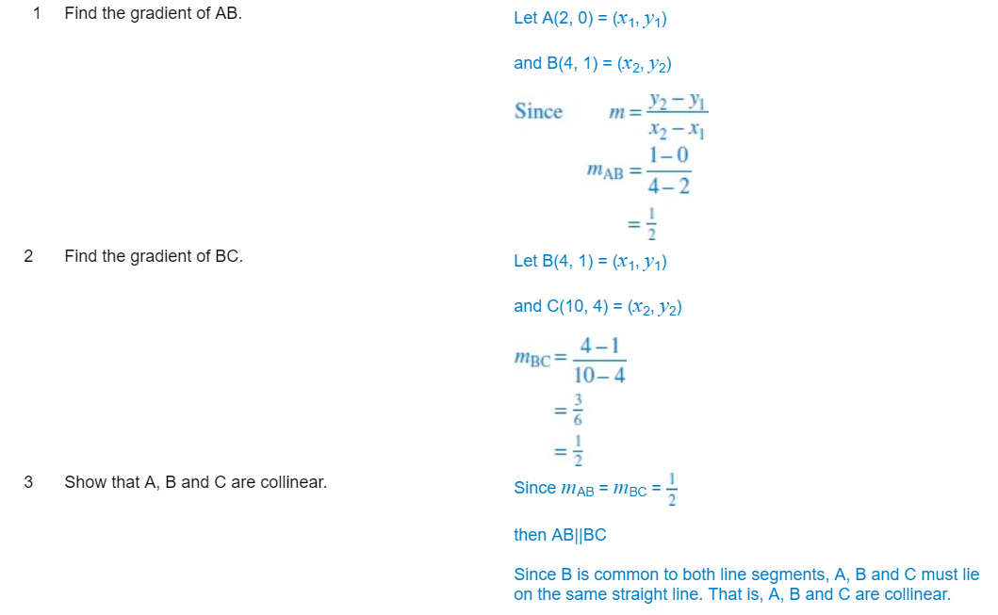
Example 2: We will do this together. Complete this in your Interactive notebook
Show that the points A(2, 0), B(4, 1) and C(10, 4) are collinear.

Slide 7
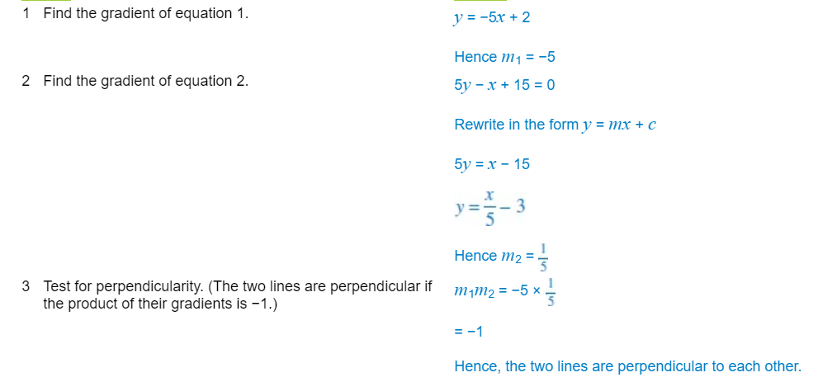
Example 3: We will do this together. Complete this in your Interactive notebook
Show that the lines y = −5x + 2 and 5y − x + 15 = 0 are perpendicular to one another.

Slide 8
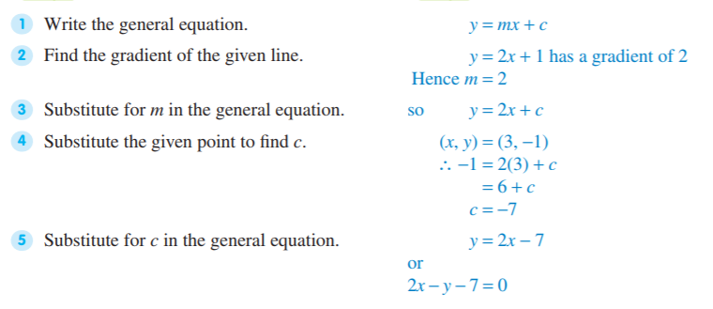
Example 4: We will do this together. Complete this in your Interactive notebook
Find the equation of the straight line that passes through the point (3, -1) and is parallel to the straight line with equation y = 2x + 1.

Slide 9
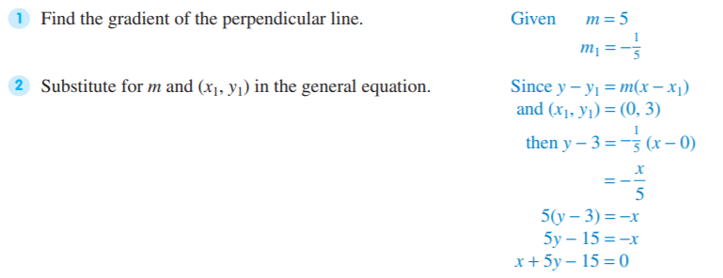
Example 5: We will do this together. Complete this in your Interactive notebook
Find the equation of the line that passes through the point (0, 3) and is perpendicular to a straight line with a gradient of 5.

Slide 10
24
7
30
Date
Linear relationships
EQ – How does the gradient differ between parallel and perpendicular lines?
Horizontal lines are parallel to the x-axis, have a gradient of zero, are expressed in the form y = c and have no x-intercept.
Vertical lines are parallel to the y-axis, have an undefined (infinite) gradient, are expressed in the form x = a and have no y-intercept.
Notes:
Input

Slide 11
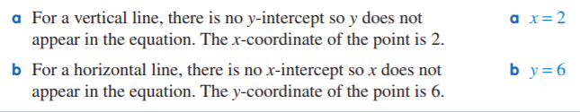
Example 6: We will do this together. Complete this in your Interactive notebook
Find the equation of:
the vertical line that passes through the point (2, -3)
the horizontal line that passes through the point (-2, 6)

Slide 12
Your turn to practice
Complete the following worksheets:
Parallel and perpendicular lines Worksheet 1(easiest)
More difficult parallel and perpendicular lines Worksheet 2(moderate- challenging)
These worksheets will be on CONNECT along with this PowerPoint to support your revision and study of this topic.
Homework/Revision
Continue to work through the worksheets above
Write your summary of this topic

